Slide 1
MODELING THE GROWTH OF AQUATIC ORGANISMS
Joseph T. DeAlteris
University of Rhode Island
Kingston, RI

Slide 2
Objective
To develop a quantitative relationship that predicts fish size at any given age, or conversely age at any given size.

Slide 3
Critical Input Parameters
Size of Animal
- Length, width, depth
- Volume, weight
Age of Animal

Slide 4
Age of Aquatic Animals
Growth rings on scales, otoliths, and vertebra for finfish species for temperate species.
Size classes for tropical species or species with no hard parts.

Slide 5
Growth Rings on a Fish Scale

Slide 6
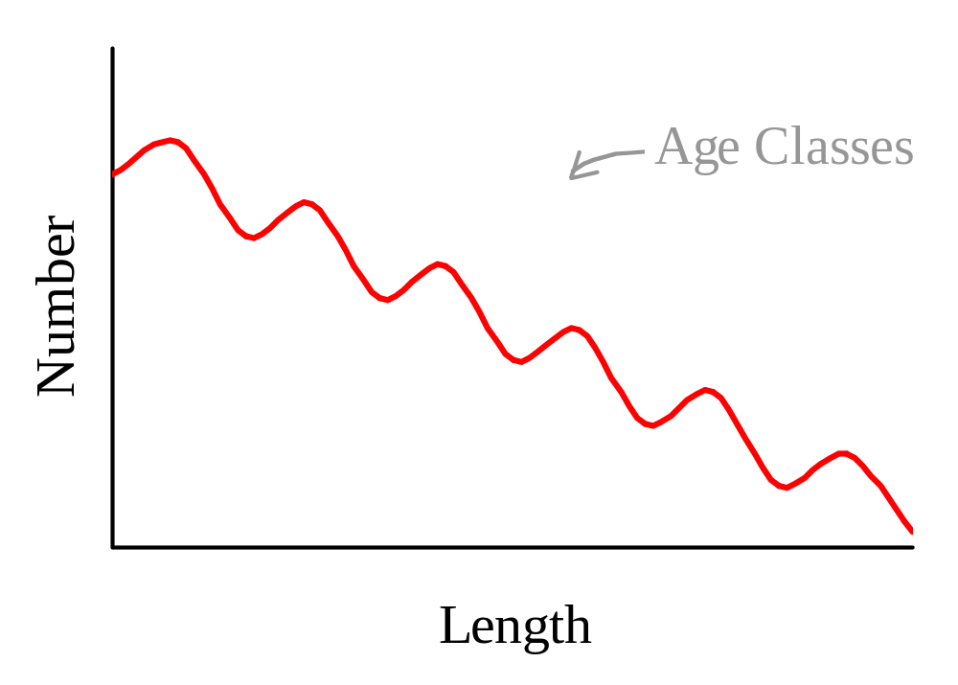
Multi-Modal Length Frequency Distribution
0
↑
1
↑
2
↑
3
↑
4
↑
5
↑

Slide 7
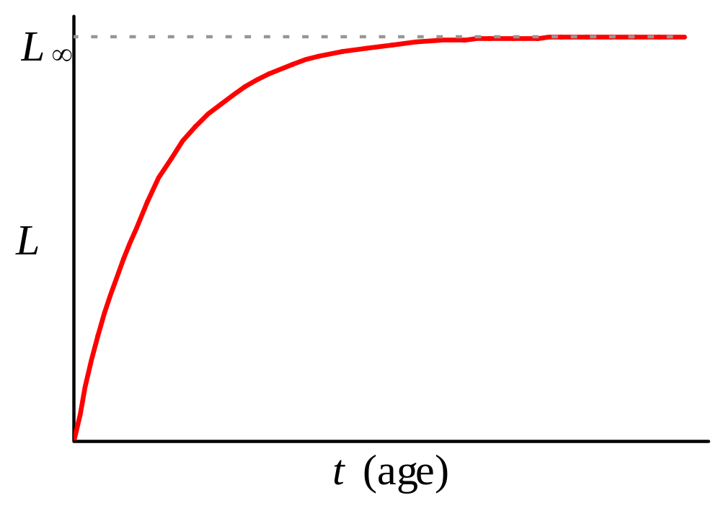
Von Bertalanffy Growth Model (1938)
Length, width, or depth

Slide 8
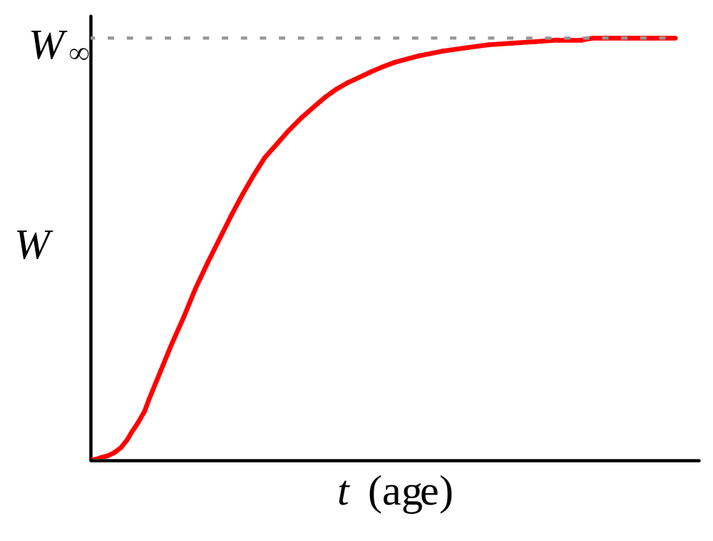
Von Bertalanffy Growth Model (1938)
Weight or Volume

Slide 9
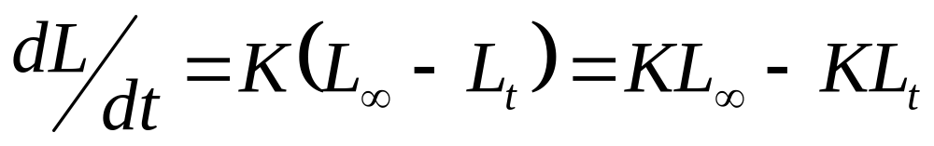
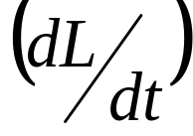
Von Bertalanffy Growth Differential Equation for Length
Assumes: (1) Rate of growth is linearly related to length (L_{t}).
(2) Growth coefficient (K) is constant.
(3) Maximum length is L∞

Slide 10
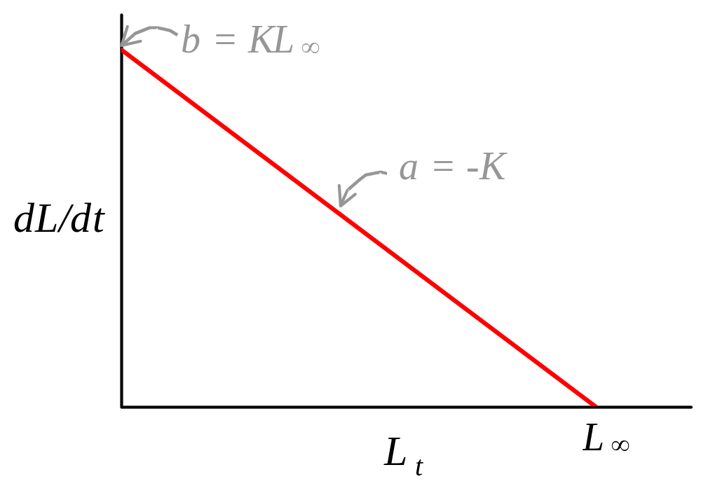
Linear Relationship Between Growth Rate and Length (L_{t})

Slide 11
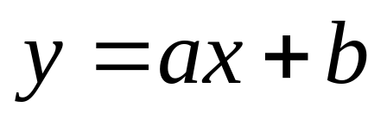
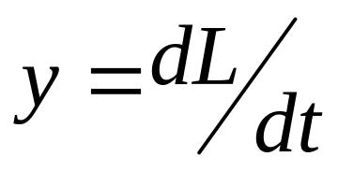
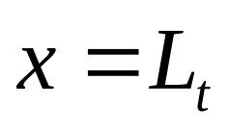
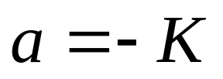
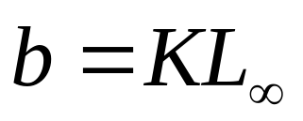
Von Bertalanffy growth equation for length has the form of a linear model:
Where:

Slide 12
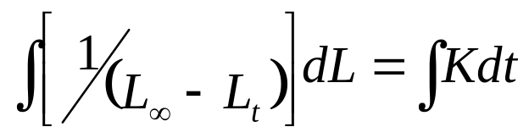
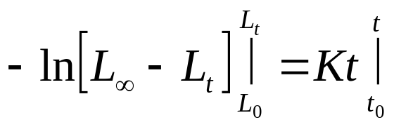
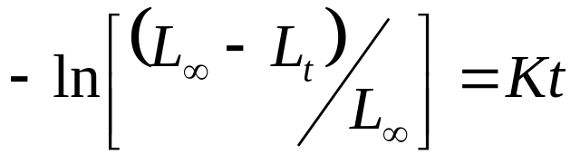
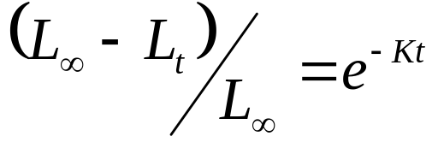
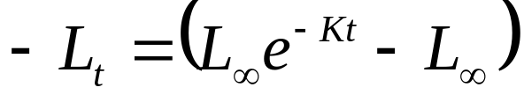
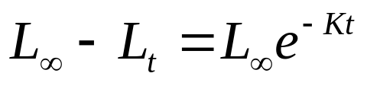
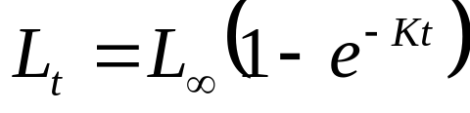
Von Bertalanffy growth equation for length also is a differential equation, that is solved by Separation of Variables technique
Based on integral tables,
Assuming t₀=0 and L₀=0, and substituting,
Taking the inverse natural log, or exponential, and rearranging yields:

Slide 13
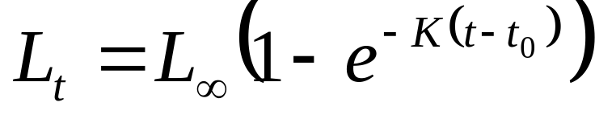
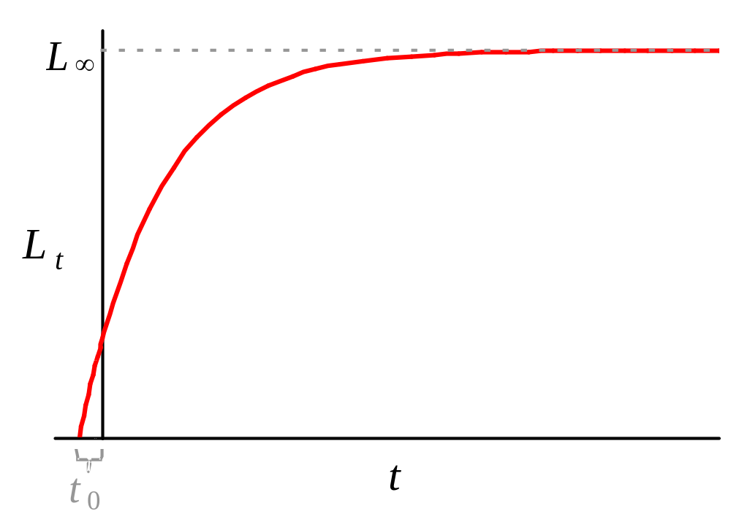
Corrected von Bertalanffy Growth Function for Length

Slide 14
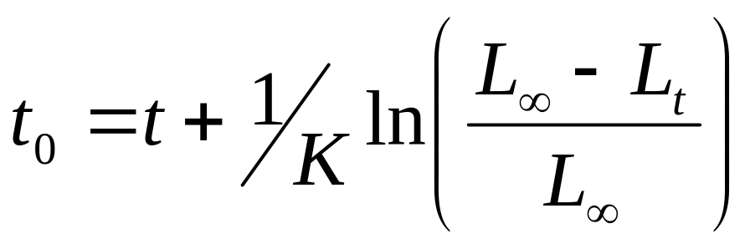
t₀ is estimated by rearranging the von Bertalanffy function, solving for t₀, and substituting values for t and L_{t} at the youngest age:

Slide 15
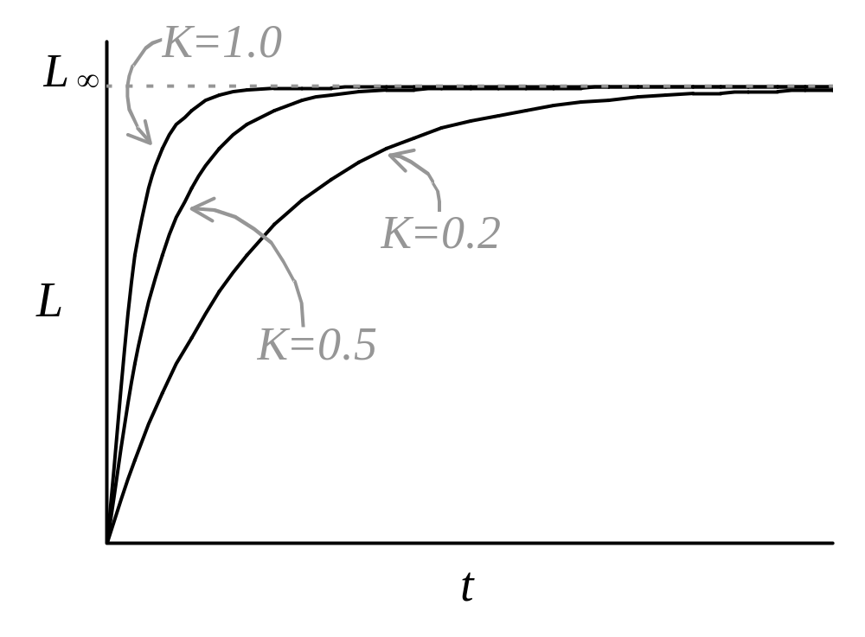
Effect of the Value of the Growth Coefficient (K) on the Growth Curve

Slide 16
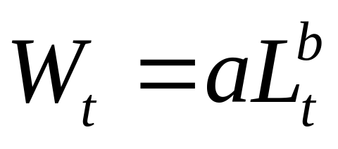
Weight-Length Relationship
Where: a is the unit conversion coefficient
b is the volumetric expansion coefficient

Slide 17
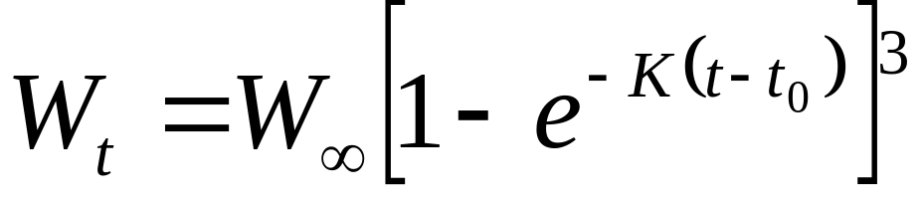
Von Bertalanffy Growth Equation for Weight
Note: von Bertalanffy assumed a value of b = 3 (i.e. isometric or proportionally equal growth in length, breadth, and depth).

Slide 18
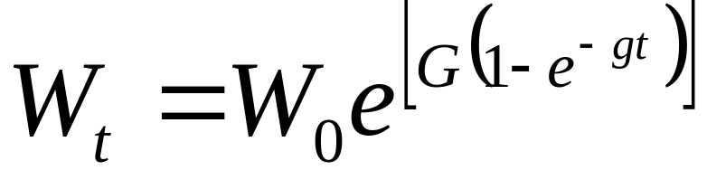
Gompertz Growth Equation for Weight
where W_{t} is weight at time t,
t is the age of fish,
W₀ is a hypothetical weight at t = 0,
G is an instantaneous growth parameter when t = 0, and
g is the instantaneous rate of decrease of the instantaneous rate of growth (G).

Slide 19
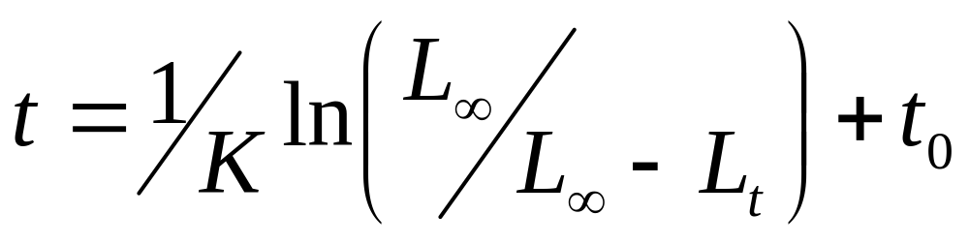
Estimating Age at Length Based on von Bertalanffy Equation
(back-calculating age from length)

Slide 20
Estimating Growth Equation Parameters
Gulland-Holt Method (1959)
Ford-Walford Plot (1946)
Non-Linear Regression Methods (Excel 1998)

Slide 21
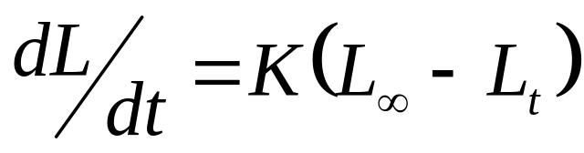
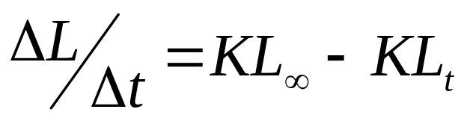
Gulland-Holt Method
Based on the von Bertalanffy growth rate differential equation.
Assumes uniform growth between two ages.
or

Slide 22
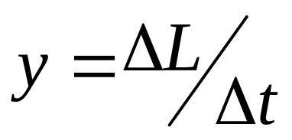
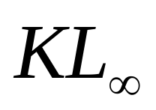
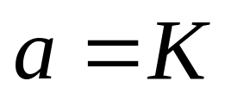
The growth rate equation has the form of a linear model:
Where:
b = y-intercept =
, the growth coefficient

Slide 23
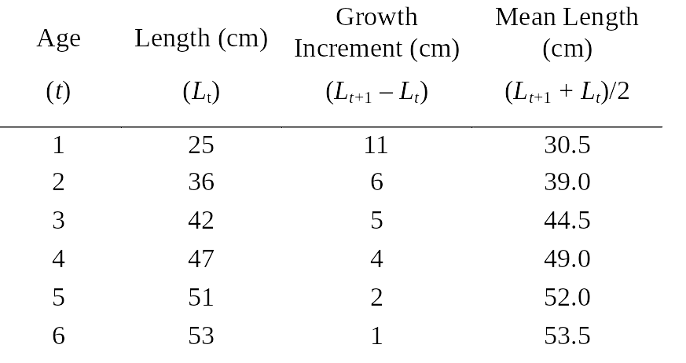
Given Age-Length Data for a Fish Species

Slide 24
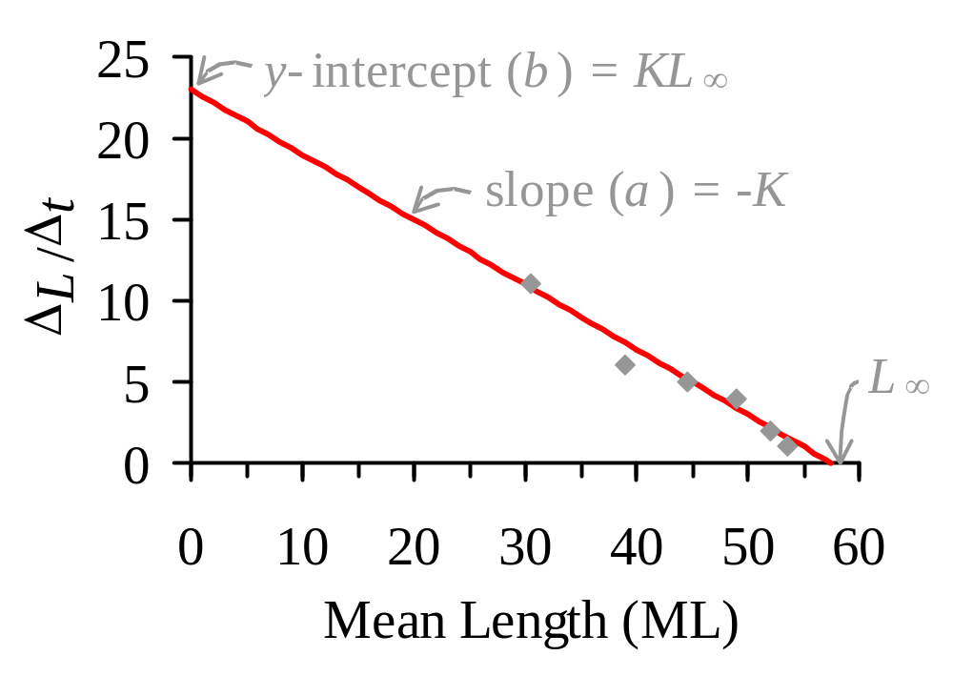
Gulland-Holt Plot of Growth Rate Against Mean Length

Slide 25
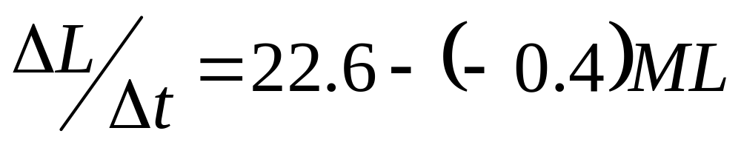
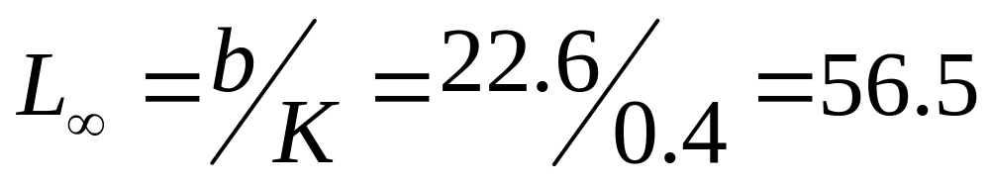
Results of Linear Regression Analysis
Therefore: K = 0.4
cm

Slide 26
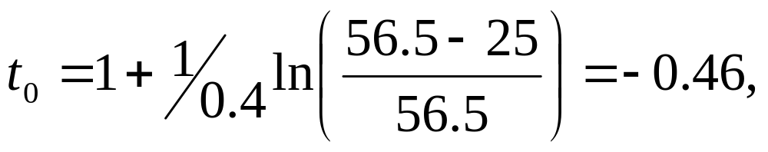
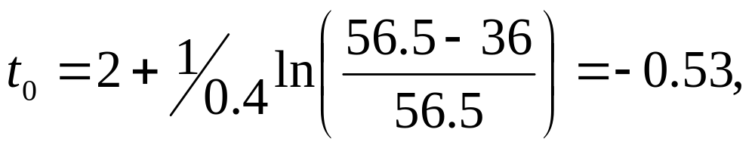
Estimating t₀
For t = 1 and L_{t} = 25,
and for t = 2 and L_{t} = 36,
The mean t₀ is -0.495

Slide 27
Ford-Walford Plot
Requires equal time increments (T) between measures of fish length
Plot of L_{t+T} versus L_{t}
Plot includes line of L_{t+T} equal to L_{t}

Slide 28

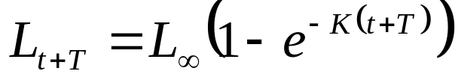
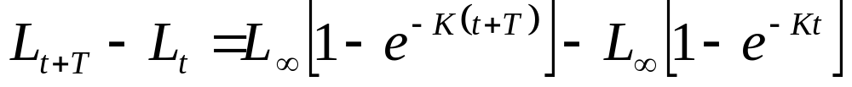
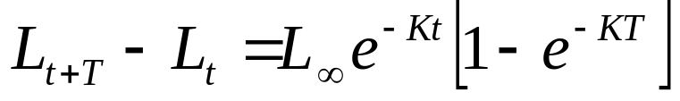
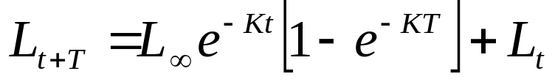
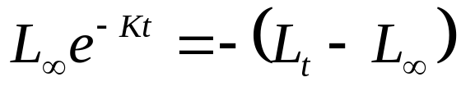
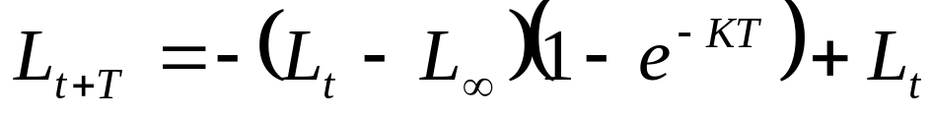
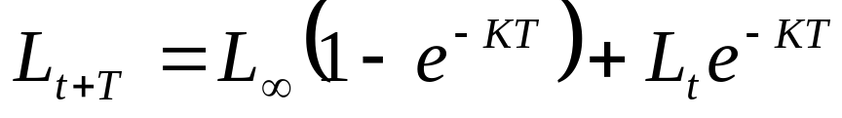
The derivation of the Ford-Walford plot is based on the von Bertalanffy function for ages t and t+T: and
Subtract L_{t} from L_{t+T} and solve for L_{t+T}:
Substituting into the above equation and simplifying yields:

Slide 29
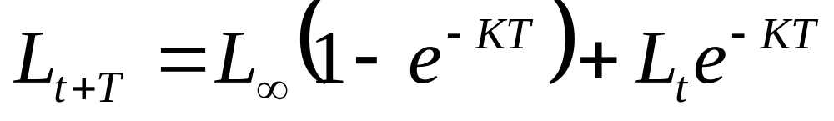

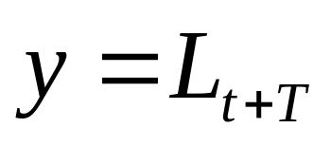

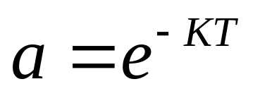
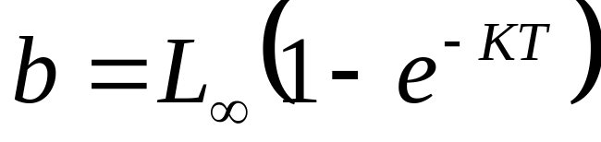
has the form of a linear model:
Where:

Slide 30
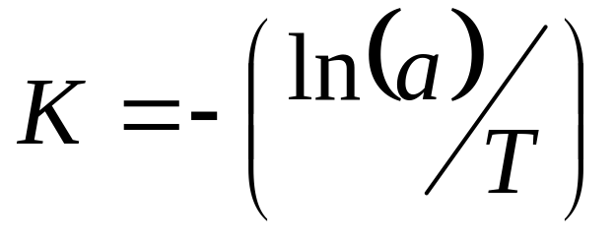
Since the slope of the regression line is a = e^{-KT},
If T = 1, this equation simplifies to K = -ln(a)

Slide 31
L∞ is estimated graphically by the intercept, or algebraically by setting the no growth equation (y = x) and the growth regression equations (y = b + ax) equal to each other, and solving for x.

Slide 32
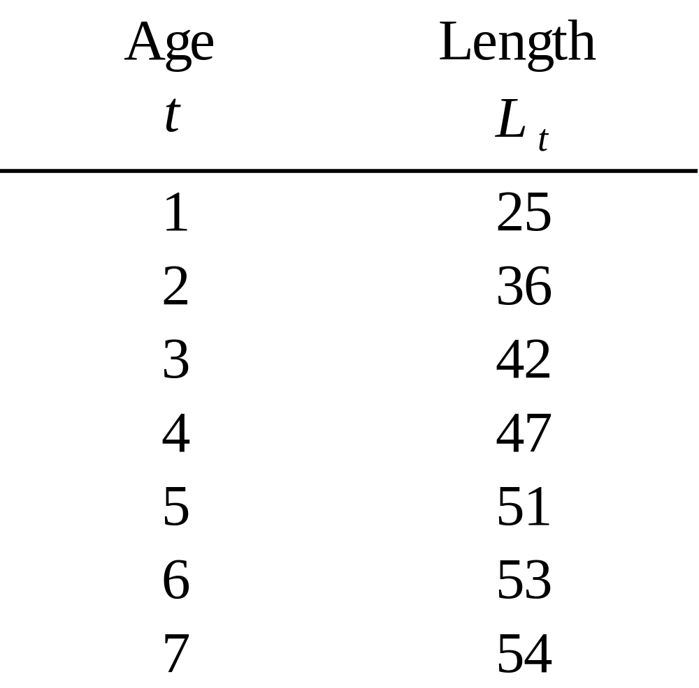
Given Age-Length Data for a Fish Species

Slide 33

Ford-Walford Plot of Length at Time t+T versus Length at Time t

Slide 34




Regression equation is:

Slide 35
Non-Linear Regression Methods
A computer algorithm is used to iteratively fit new parameter values to a model to minimize the sum of the squared differences between observed and predicted values.
Solver in Excel.

Slide 36

Excel Spreadsheet Set-up

Slide 37

Excel Spreadsheet Solution

